Slide 1
Technological Advancement of Warfare and IHL
Vivek Raval

Slide 2
Introducing the 21st Century
To begin with...what kind of world do we live in?
February 2003 – three hackers disrupted the US logistics planning for the US operations in the Persian Gulf
Internet is used by 1.7-2 billion people
50% of world population lives in the cities
Globalisation is on the rise – over 550 million people relocated across borders annually, over 6 million people fly daily
India+China = 35% and the US+EU = 60% of the world economy (there are 192 United Nations’ member states!); of the 100 largest ‘economies’ in the world only 47 are states, the rest are multinational corporations

Slide 3
The world is rapidly becoming a ‘global village’ connected at various levels by new technologies, integrating economy and societies
Does it mean that we solve our conflicts differently? Have we become more peaceful, do we fight differently?
Are we witnessing changing conflicts in a changing world? Has information warfare gained a special role in these conflicts or has it become a way of fighting a conflict in its own right?

Slide 4
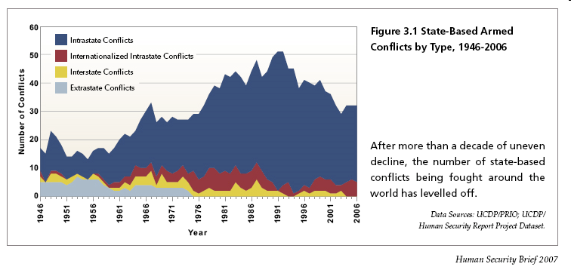
Conflicts 1946-2006
Source: Human Security Brief 2007, Vancouver: Simon Fraser University

Slide 5
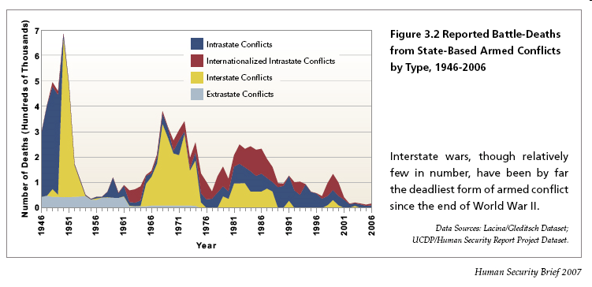
Civilian Deaths: Interstate Conflict
Source: Human Security Brief 2007, Vancouver: Simon Fraser University

Slide 6
Introduction:changes in warfare and in constitutional order
Innovations | Princely state 1494-1572 | Kingly state 1567-1651 | Territorial state 1649-1789 | State-nation 1776-1870 | Nation-state 1861-1991
Constitutional | -Consistent finance -Permanent government | -Absolutism -Sectarianism | -Trade control -Aristocratic leadership | -Nationalism -Imperialism | -Nationalism -Ideology
Warfare | -Use of mercenaries -Mobile artillery -Fortification | -More firearms -Siege warfare -Standing armies | -Professional armies -Limited wars | -Mass conscription and mass armies -Decisive battles | -Nuclear weapons -Rapid computation -International communica-tions
Source: Bobbitt, P. (2002) “The Shield of Achilles”, London: Penguin Books, pp.346-347

Slide 7
Introduction:basic terms
Information warfare/operations (IW/IO) is...
...the integrated employment of (1) the core capabilities of electronic warfare, (2) computer network operations, (3) psychological operations, (4) military deception, and (5) operations security, in concert with specified supporting and related capabilities, to influence, disrupt, corrupt or usurp adversarial human and automated decision-making while protecting our own

Slide 8
The evolution of information society seems to be transforming war into a communication campaign of violent and destructive messages
Information society (i.e. growing access to technologies that could be used for destructive purposes as well as growing vulnerability of society) enables smaller groups to challenge states
Does it all mean fading of nation-state and emerging of a new constitutional order (market state – P.Bobbitt) remains to be seen and will be discussed during the course

Slide 9
MILITARY TECHNOLOGIES
Intelligence and counter-intelligence security methods
Psychotropic weapons
Firearms
Electromagnetic pulse weapons
Tectonic weapon
Military medicine
Anti radar materials
Military positioning and navigation systems
Reactive materials in warfare
Enemy detection systems
Anti-missile shield
Soldier equipage
Mines and demining technologies
Laser weapons
Cybernetic technologies in an army
Future weapons
Military electronics
Military training facilities
State border protection systems
Non-lethal weapons
Space weaponry technologies
Amours and their technologies
Plasma weapons
Communications and infor-mation encryption in warfare
Energy sources in an army
Military positioning and navigation systems
Weapon manufacturing technologies

Slide 10
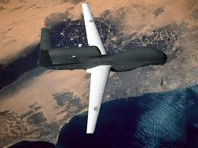
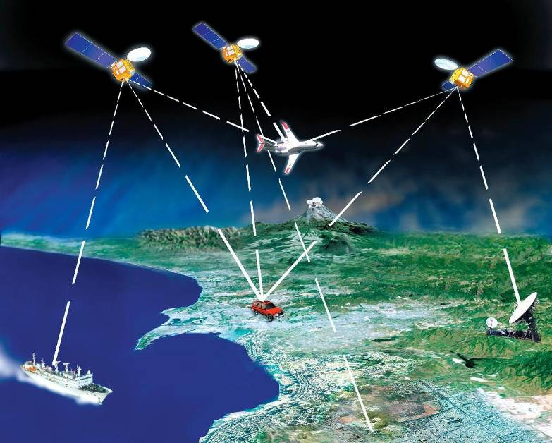
BATTLEFIELD RECONNAISSANCE
The aim:
  the exploration of the future battlefield;
  receiving the information on the enemy's force
  structure, its location, and potential.
Means:
  unmanned air vehicles;
  radars;
  sonars;
  space satellites.

Slide 11
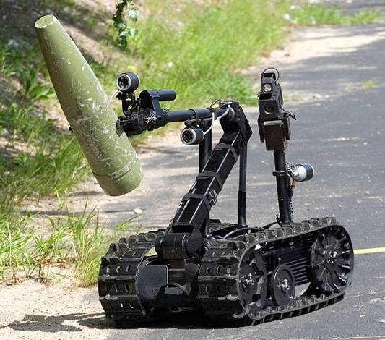
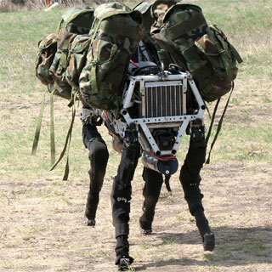
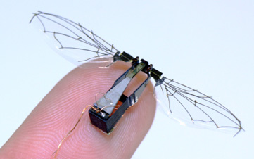
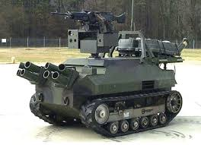
MILITARY ROBOTS
Robots play a constantly increasing role in warfare – they are unmanned aerial reconnaissance and combat vehicles, demining robots, (e.g. “SPIKER”, “RASP”), universal military robots capable of substituting soldiers (“Warrior 700”), robots making corridors in mine fields etc. Nevertheless, the ethical issues on the applications of robots in warfare and the problems of the latters’ consistency with Geneva conventions appear already.

Slide 12
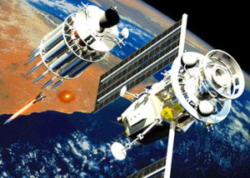
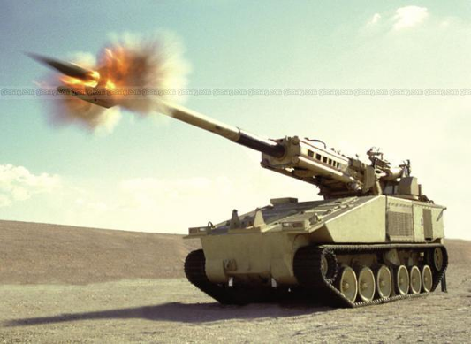
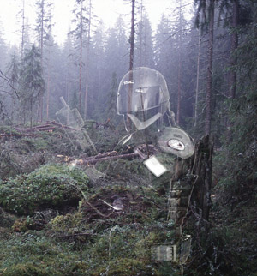

FUTURE ARMAMENT PROJECTS
Futuristic armament projects:
  “God rods”;
  “Metal storm”;
  Powerful electromagnetic guns;
  High power chemical laser;
  Cavitation torpedo.
This was only a few examples of futuristic projects. Some of them will be implemented and others probably not, but in general their ideas are actual not only for warfare. We would like to believe that such technologies will never be used according to their direct destination, but will be applied by mankind for peaceful purposes.

Slide 13
A classification of systems
Controlled
Supervised
Automated
Autonomous

Slide 14
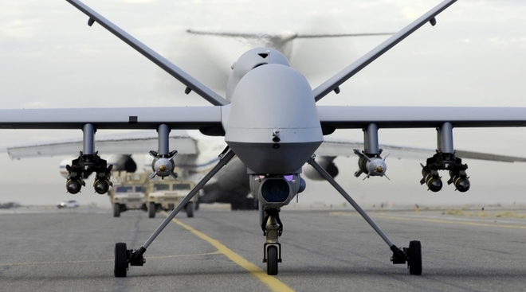
Controlled
A system that requires activation, direction and manipulation by a person ("man in the loop").

Slide 15
Supervised
A system is essentially an automated weapon or that has some degree of self-function but this function is permanently supervised by a human operator.
Operator supervises, does not initiate every function but may, at any time, block or take over the automated function of the system. ("man in the loop").

Slide 16
Automated
A system functions in an independent manner and does not require the intervention of a human operative for activation, direction, manipulation, nor for any other function.
System is pre-programmed in a specific manner and cannot adapt its function outside those parameters.
"Fire-and-forget" or "target-and-forget systems.

Slide 17
Autonomous
An automated weapon that can adapt its function to changing circumstances.
This is the world of artificial intelligence.

Slide 18
IHL does NOT prohibit technological developments for war fighting BUT these developments MUST be measured and assessed against existing legal norms.

Slide 19
Rule of Distinction
Obligation to distinguish at all times:
civilians and other protected persons from combatants
civilian objects from military objectives

Slide 20
Indiscriminate attacks are prohibited
attacks not directed at a specific military objective
means and methods of warfare that cannot be directed at a a specific military objective

Slide 21
Proportionality in attack
It is prohibited to launch an attack which may be expected to cause
incidental loss to civilian life, injury to civilians, damage to civilian objects which would be excessive to the military advantage anticipated.

Slide 22
Propositions …
Current IHL covers controlled systems
Current law covers supervised systems
Current law should cover automatic systems
Current law may not be enough for autonomous systems

Slide 23
Issues and concerns
Autonomy: the absence of a "man in the loop" and related issues of target identification
Application of IHL rules distinction, proportionality and precautions. Is it feasible to program IHL compliance?
Where would liability/responsibility lie for failure or violations?

Slide 24
Other issues
Cyber warfare
Deleted uranium
Incapacitating chemical agents
The weaponization of biotechnology

Slide 25
Thank You

